Slide 1
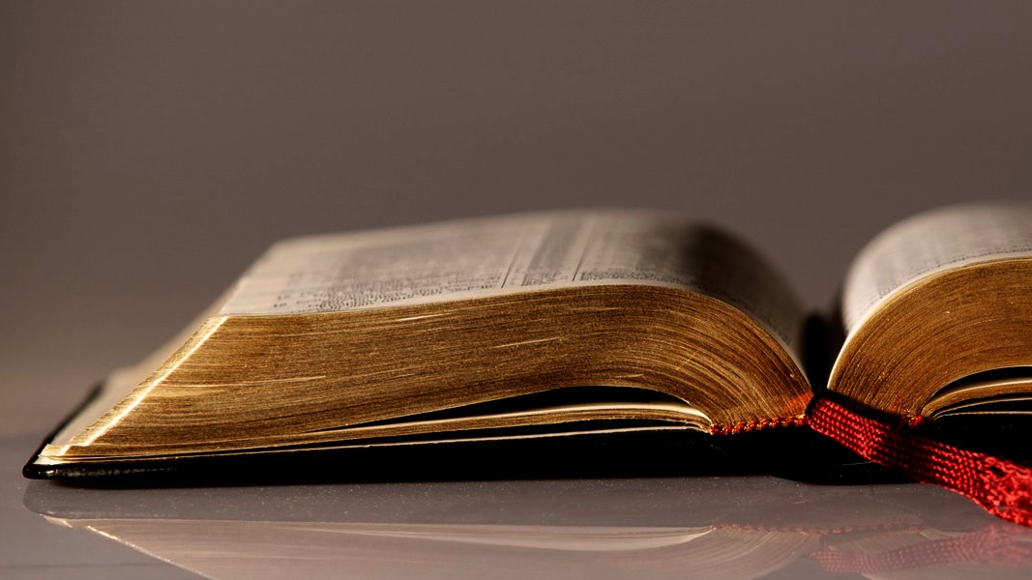
Welcome to
Our Sunday School
We’ll start at 9:07
visit OurSundaySchool.com for more about our class

Slide 2
Today’s class (pages 24-28)
Philippians 1:3-4a

Slide 3
Philippians 1:3-4a (CSB)
I give thanks to my God for every remembrance of you, always praying with joy

Slide 4
Today’s class (pages 24-28)
Philippians 1:3-4a

Slide 5
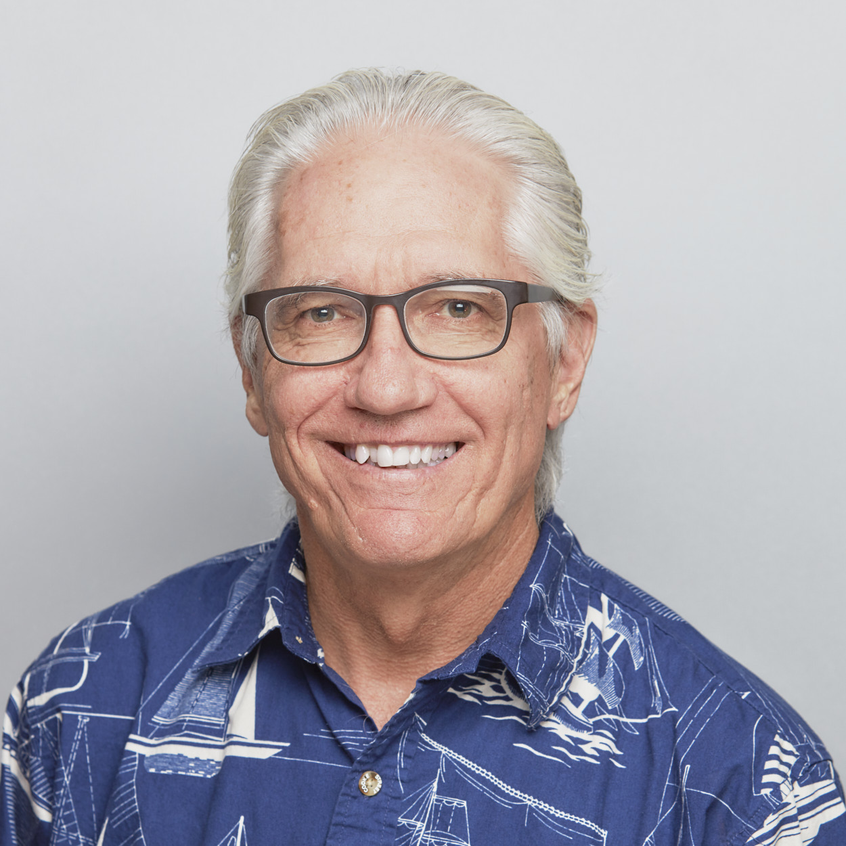
Dr. Joe Hellerman
Authors often thanked a deity in ancient letters, and Paul may be adapting a common formula.

Slide 6
Today’s class (pages 24-28)
Philippians 1:3-4a

Slide 7
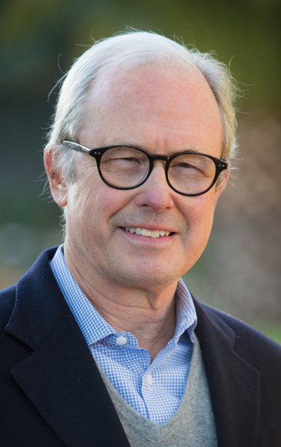
Dr. G. Walter Hansen
Paul lets his readers listen in on his prayers of thanksgiving and intercession for them.

Slide 8
Today’s class (pages 24-28)
Philippians 1:3-4a

Slide 9
Prayer Time
Write down your prayer requests (on the Weekly Update or in the comments)
Lean in, engage, and pray for someone not with you
Go worship

